Slide 1
CODE QUEST
BLUE TEAM
Presentation

Slide 2
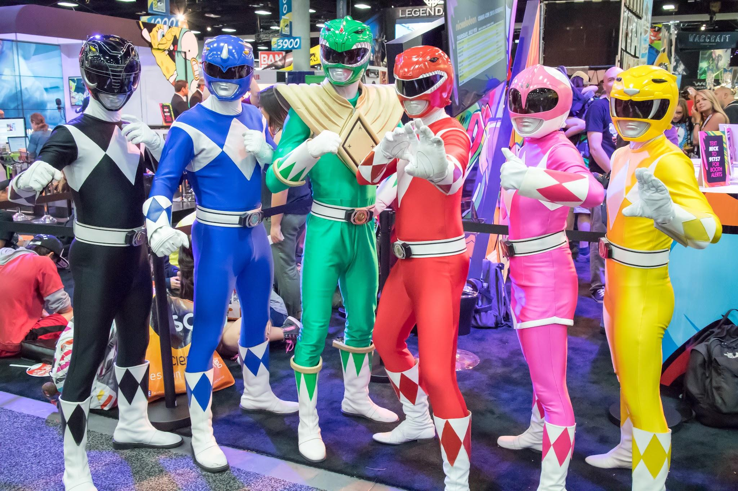
Team Members
Jenna Benedict Sheena Wayne Moussa

Slide 3
Code Quest - Plot and Story
“Code Quest” is a branching path, text based, dungeon crawler made in Python.
The player will control a named protagonist through a monster infested dungeon. Each room will offer a unique scenario with a monster or NPC that the player will sometimes have the option to engage with or to flee from. Certain encounters will be luck based, some will be choice driven, and others will test the players intellect. Code Quest is a humorous short adventure that is fun for all ages and available on various platforms.

Slide 4
Code Quest - Planning
Code Quest was designed with a singular ending win condition in mind but multiple ways to progress and many game over failure conditions.
Our Lead Creative, Benedict, was responsible for the premise and using the initial brainstorming session and various notes made on Trello during the planning phase he mapped out the core plot, characters and scenarios before submitting his proposal at the next team standup meeting.

Slide 5
Code Quest - Planning cont.
Due to the project brief specifications a dungeon crawler felt like an easy fit and Benedict was able to draw from the choose your own adventure novels he read in his youth for inspiration and his love of fantasy fiction.
The team was very receptive of his plans but did offer alternate suggestions and ideas which were considered and discussed. Wayne suggested a Castle location due to its variety, which was an exciting premise for Benedict due to his love of the Castlevania franchise. Ultimately it was decided to keep it simple initially and look to further develop the story as a stretch goal upon completion.

Slide 6
Plan and flowchart
The majority of the team were fans of fantasy and although science fiction was suggested, as we brainstormed further most of our ideas more readily fit the fantasy scenario. As a team we wanted to draw inspiration from Dungeons and Dragons with it’s dice roll luck mechanic. Something we already knew how to implement with random number generator. We also wanted to take a dark souls approach and make player death and restart a constant factor.
Baldurs Gate inspired us to focus heavily on making a fun and engaging narrative with interesting characters, which further research concluded should be a primary focus. We began planning things out with a brainstorming session on Trello. As creative lead Benedict took minutes of the meeting and used these notes to structure a basic narrative flow. This was then discussed at length with the project manager and our planner, who formed a flowchart.

Slide 7
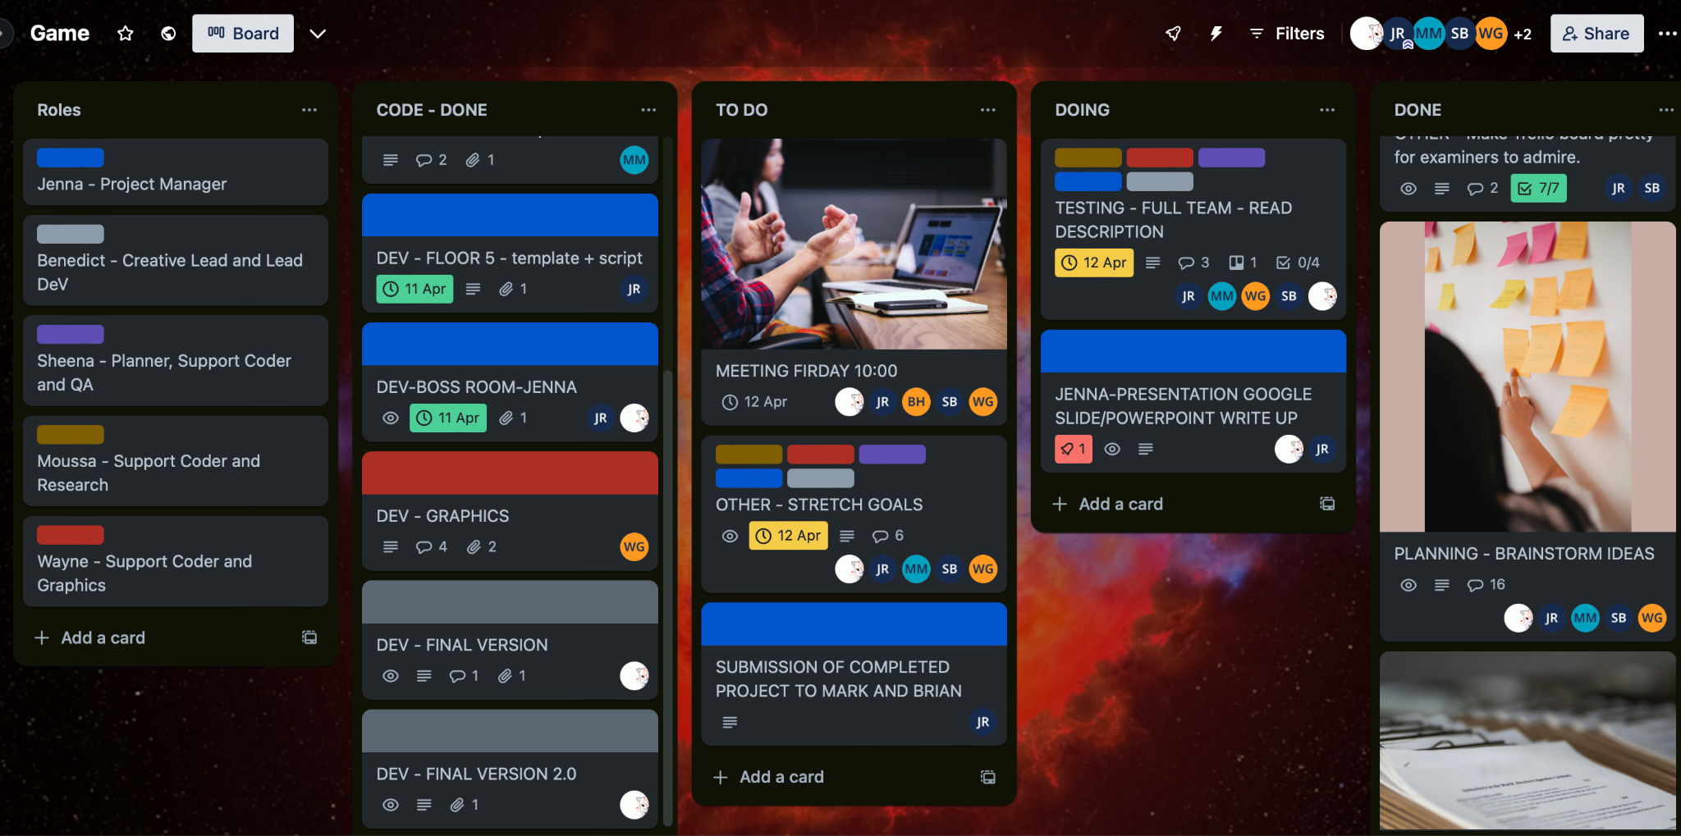
Plan and flowchart cont.
Having already decided on our roles within the team, once we had the flowchart we were able to break down all the necessary tasks and make a Trello board to aid us in managing the project and team. Trello proved to be an invaluable tool and throughout the project our proficiency and familiarity with it improved and further aided us in managing our time, duties and schedule.

Slide 8
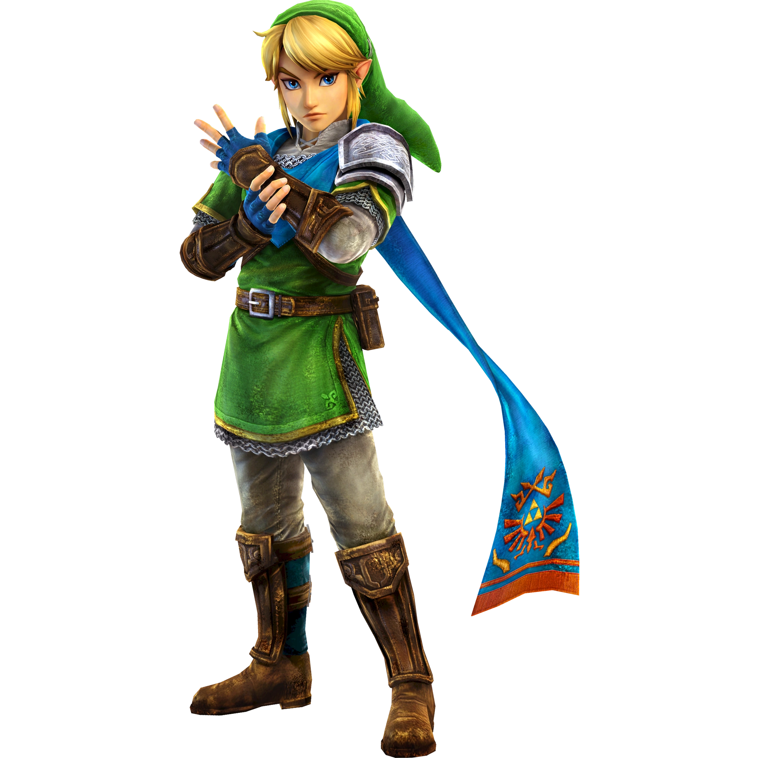
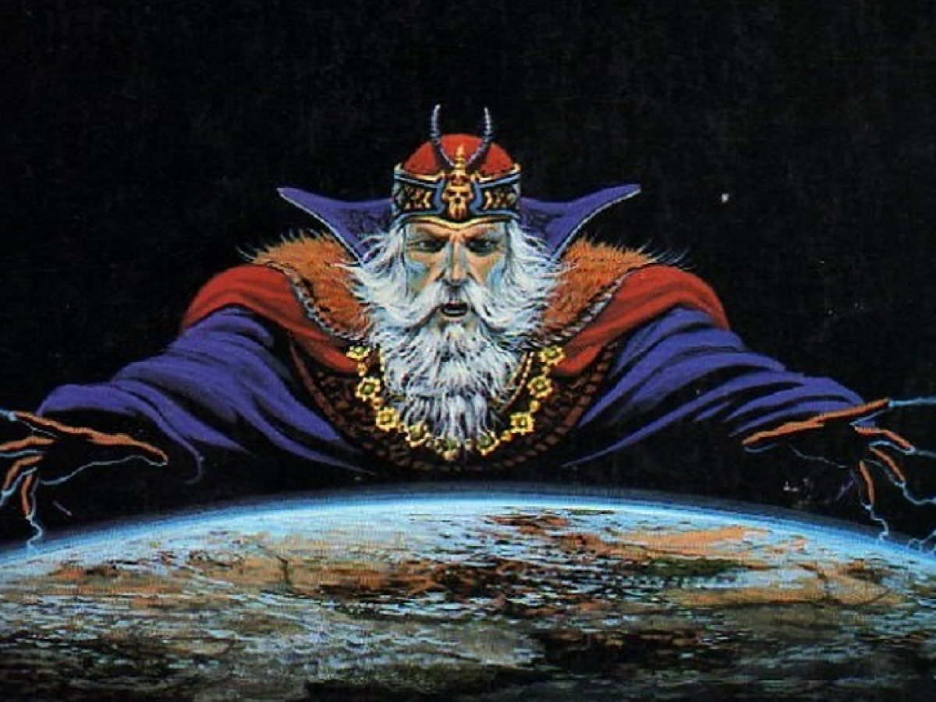
The Player
“Jeff” is a silent protagonist guided by the wisdom of the dungeon master through a dungeon labyrinth in a bid to save the Princess.
Narrator/Dungeon Master
The Dungeon Master, “Lord Python”, guides our player character throughout this adventure. What he lacks in empathy he makes up for in comedy.
Perhaps if you listen to him you may survive the tough trails ahead of you.

Slide 9
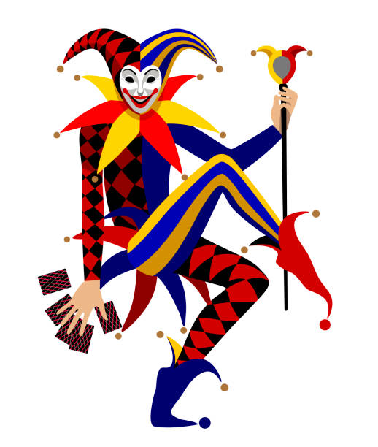
NPC/Boss’s
Each main room of the dungeon we planned to have a unique encounter. Whilst many ideas were brainstormed it made sense to include an npc/monster in each scenario to add character to each room. The Dodgy Jester
At the planning stage we all liked the idea of having ambiguous NPC characters and a joke about one being a dodgy jester was liked by all and became our first encounter. The Jester is silent to add to the ambiguity and introduces the player to the dice roll random.randint luck mechanic.

Slide 10
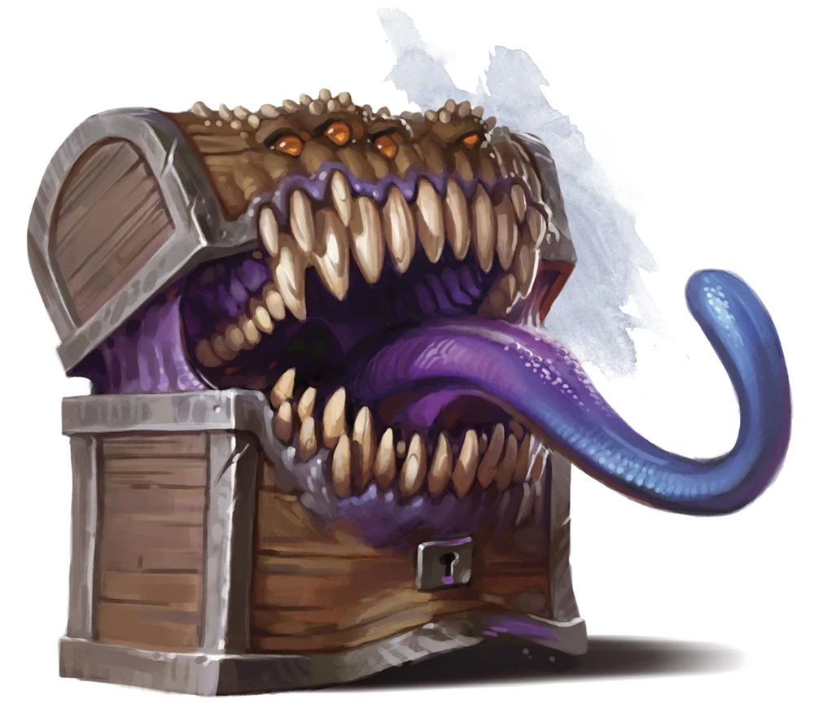
The Mimic
The Mimic! a classic D&D staple.
Our idea for the mimic had a few iterations, was it going to be the classic grow a set of teeth? Was it going to expand to a huge size and swallow you whole? Or another idea that the chest would be cursed and upon opening the gold coins would multiply so much that they would suffocate the player resulting in game over.
Ultimately it was decided to use this monster as a branching path shortcut to the final encounter, but only if the player can perform a very lucky random.randint dice roll. We decided to make this an optional encounter just like the jester as a way to ease players into the game.

Slide 11
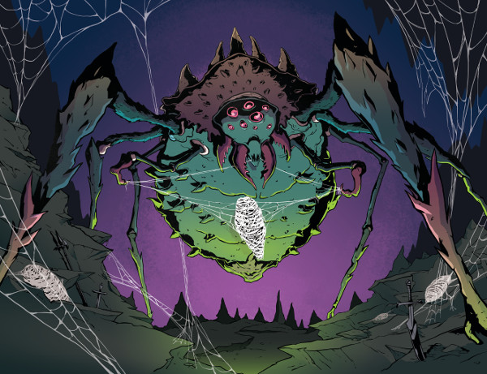
The Giant Spider
A staple horror monster that can be found in a variety of media. A monster infested dungeon without a giant spider simply wouldn’t be a true monster infested dungeon. Whilst researching our game it was noted that a rock paper scissor mechanic would be a simple challenge to code (we were mistaken, it was hard work - the dev team) and would offer a unique element for one of the room scenarios. Thus the tri-wielding rock paper scissor giant spider was created.

Slide 12
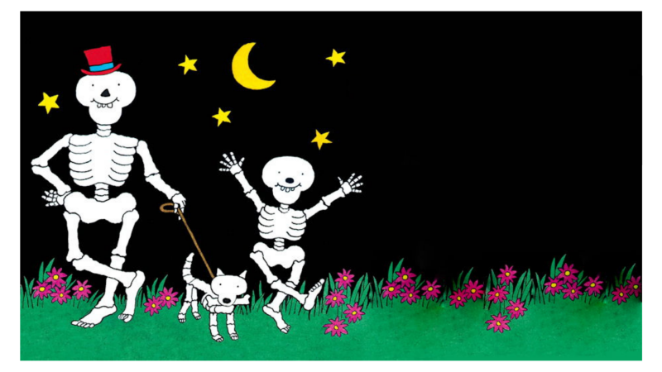
Band of Skeletons
Skeletons are another classic monster, but why stop at just one? During planning we discussed having a quiz/puzzle/riddle scenario and carried this idea forward into encountering a gang that would each ask a question that would need to be answered in order to progress. Having previously relied on luck and character choice as the determining factor to proceed through each room it was decided that a knowledge quiz would offer a unique interaction. In keeping with the comedy theme of the script we decided that cheesy dad jokes would be a fun basis for the questions.

Slide 13
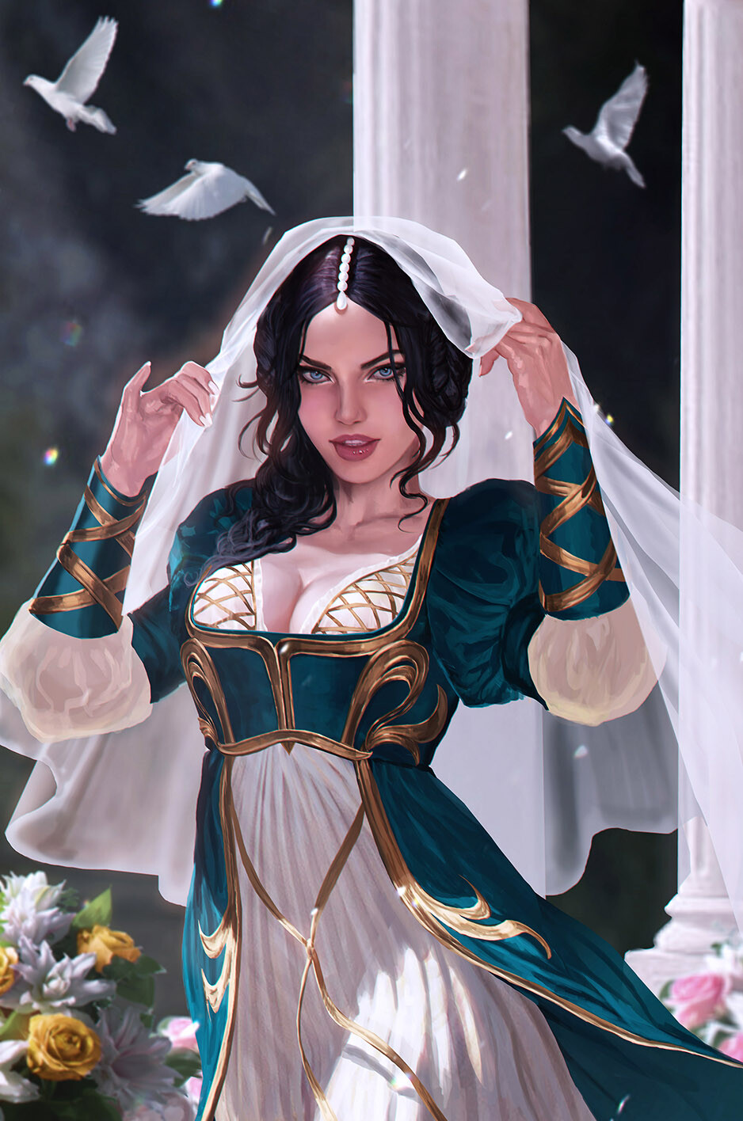
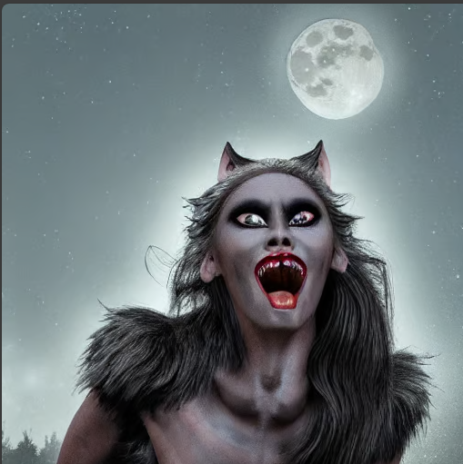
The Damsel-Werewolf
Although initially intended to just be a placeholder monster for lack of a better idea our creative lead was inspired by the ambiguous NPC idea to initially have an alluring damsel invite the player to engage only to turn monster when they did so. This idea was further expanded upon to have the werewolf remain friendly as long as the player did so too, and even offered a romance option to our narrative. The encounter has numerous player options and outcomes. We’re very pleased with this one.

Slide 14
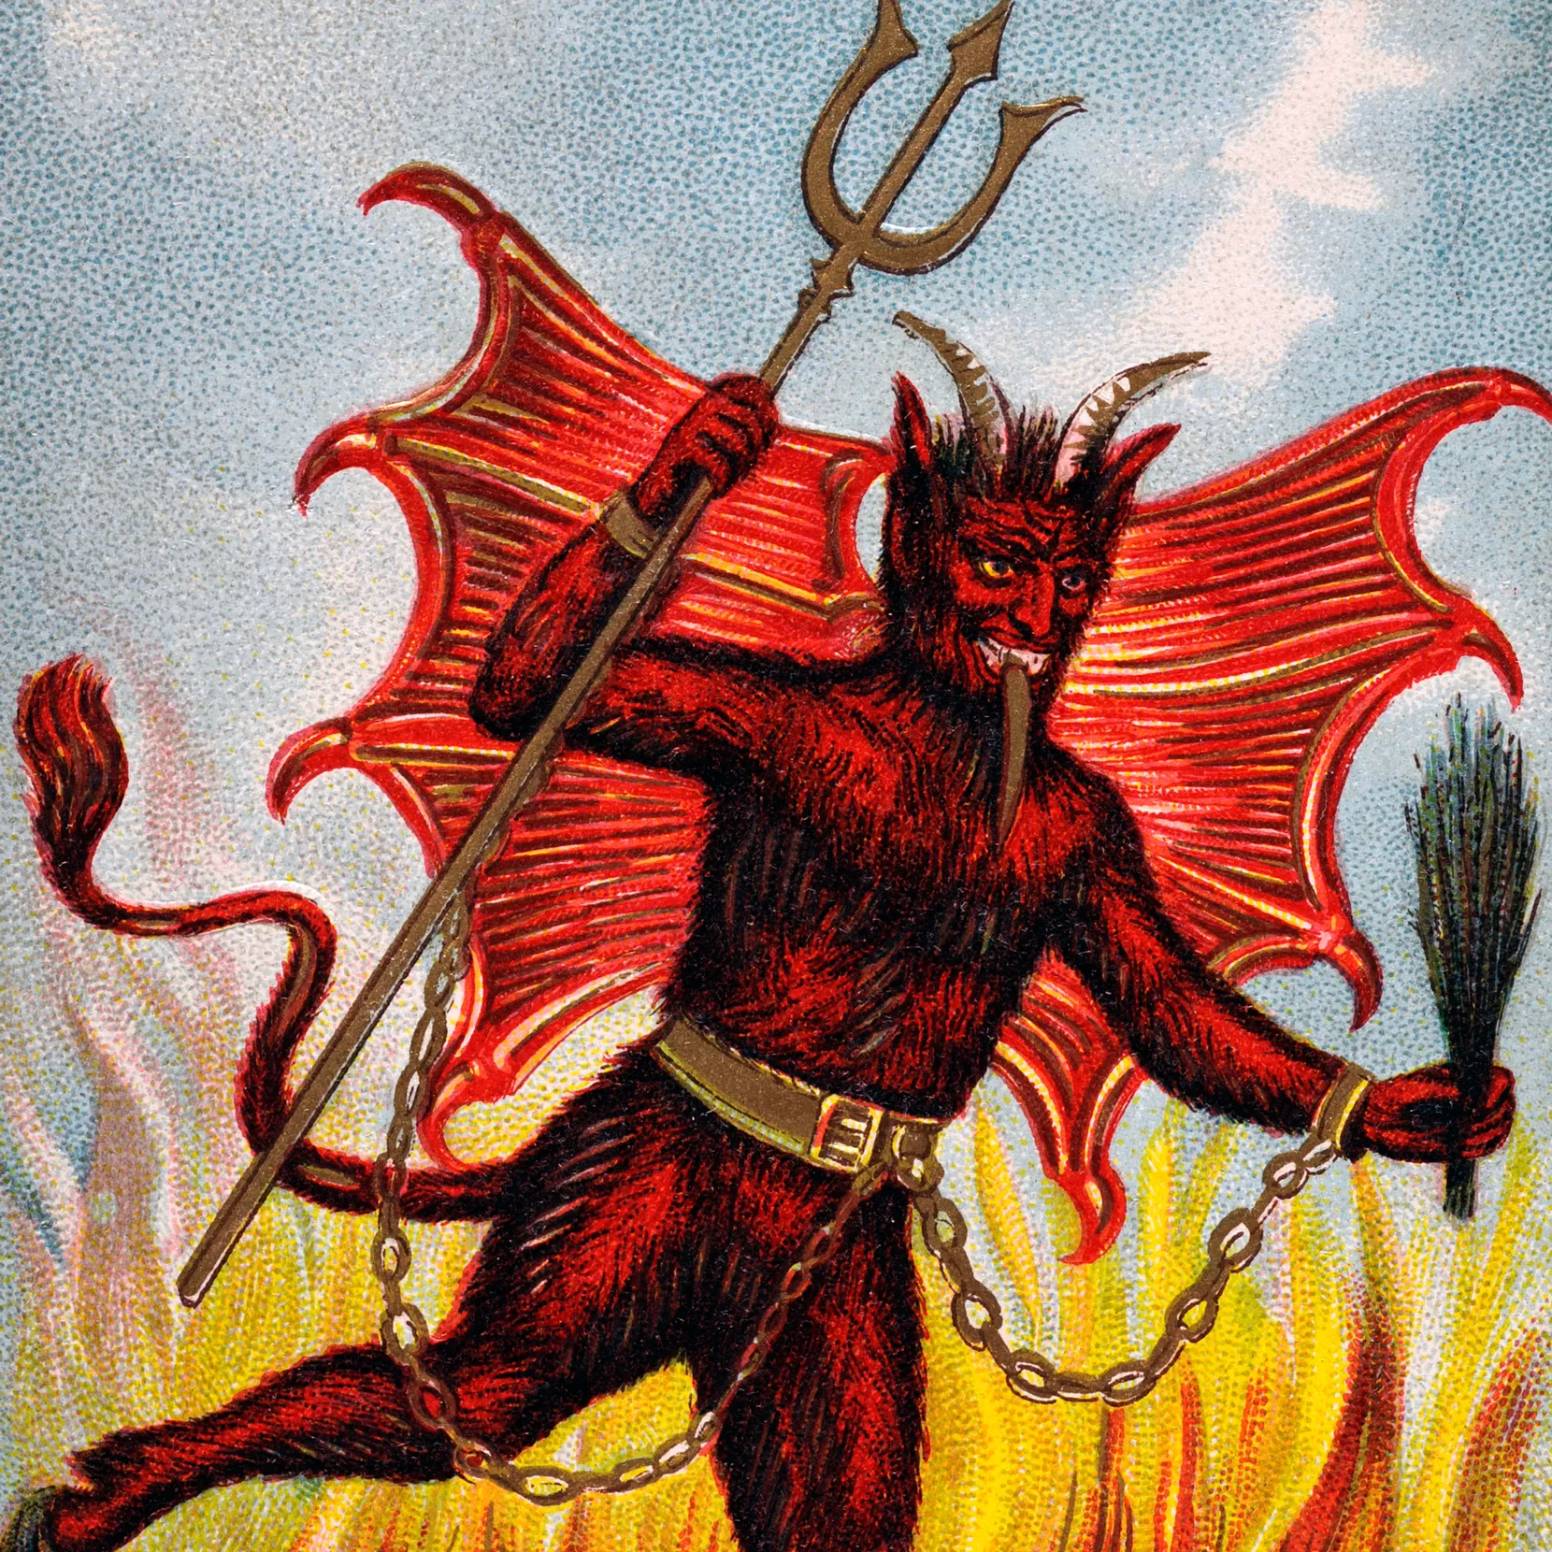
The Devil
The Devil has often been characterized as a trickster willing to play games with mortals and this was a perfect idea to run with for our finale. As opposed to the multi-choice player options of previous encounters we decided to add to the challenge by quizzing the player without any predetermined answers to choose from, in a 3 round quiz. To add to the uniqueness it was decided to have each question be a different type of question, involving; memory, mathematics and finally (typical of the Devil) a question with no obvious answer. Despite being stated as a best of 3 the Devil will cheat and force the player to answer all 3 questions if they succeed with just the first 2.

Slide 15
TEAM BLUE
Our team was predetermined for this project. Once given the brief we set up an initial meeting for the sake of introductions and team building. The intention was to keep things light hearted and discuss casually how we felt about the project, what hobbies/interests we could draw inspiration from and ultimately what roles we wished to take up for this project.
We decided upon the major roles that needed filling and allowed for people to volunteer themselves for each role. This worked swimmingly with nobody left dissatisfied with their role. The roles we decided upon were a project manager, a lead developer, a lead creative, a planner/QA task master, support coders, researcher and graphic artist.

Slide 16
BLUE TEAM - GOALS
Our goals were firstly an interesting narrative. To achieve this we needed interesting characters, scenarios and an amazing script writer.
Key features we wanted to include were the variety of each scenario and an interesting aesthetic for the terminal. This posed some interesting coding challenges of which we needed to research and learn, including ASCII art which was researched and implemented by Wayne.
Despite an initial plan to keep things simple our creative lead encouraged us to challenge ourselves in all aspects of the game and many things were researched, including coloured text, typewriter effect, animations and many different game options for the scenarios. Many of these options proved to be too much for the deadline and our schedule. They expanded beyond our initial flowchart and were added to our stretch goals.

Slide 17
BLUE TEAM - ROLES
JENNA RETI - PROJECT MANAGER, ASSISTANT CREATIVE
My First priority was to think about our groups strengths and weaknesses: I discussed with my team that my potential strengths would be best put towards the project management side of things. I already had experience managing personal projects on Trello and despite being an introverted person I felt this would be a good opportunity to challenge myself and develop a new skill set.
Upon assuming the role of project manager, a significant challenge emerged early on as we faced the departure of our lead developer. In response, we swiftly assessed our team's capabilities and determined that Benedict would be best suited to take on this responsibility. Leveraging his strengths, I offered my help to assist, ensuring the workload remained manageable for him.
With the added pressure it was essential to remain focused and organised. In order to do so I put a lot of effort into maintaining our trello board and going over it with the team at the start of every meeting. I organised all Tasks into 3 columns: To Do, Doing, Done and included an additional column for all links of completed to be attached to for easy access.
I set our team S.M.A.R.T Goals to help our progress, using the Trello board to set time, dates and checklists for goals, and stand up meetings. Everything was colour coded and bannered for easy readability.
I made every effort to assist each team member if they required it and made sure they knew I was available at any time. I felt that it was prudent to lead by example and thereby volunteered to take up any new task that became necessary or discussed or delegated the task to whoever was responsible for it. As Benedict had a lot of responsibilities I offered to job share some of his duties.
This was my first ever experience managing a team in this kind of setting and taking on such a big responsibility. I am proud of my accomplishments and feel that the team was successfully led. If I was to choose any aspect that I could improve upon I would say it would be delegating work rather than taking full responsibility myself.

Slide 18
BLUE TEAM - ROLES
BENEDICT STREET - LEAD CREATIVE, LEAD DEVELOPER, ASSISTANT PROJECT MANAGER
Initially I was tasked with being creative lead. I volunteered for this role as it lends itself towards my strengths in my artistic ability and creative writing skills. Unfortunately our lead developer was unable to participate, we had another absentee team member leaving us with only 4 members. Our instructor saw the potential in me and told me to take over as lead developer. With such a heavy influence on all aspects of the project I spoke with our project manager and told them that I felt it would be of huge benefit if we job shared the project management so I had their blessing to actively direct the team.
They agreed that this would be beneficial for the project and volunteered to aid me in any way they could which proved invaluable throughout the entire project. During this time we held extra stand-ups between the two of us to discuss how the project was progressing and what needed to be prioritised from our co-members.
I was able to complete all of my goals but it did require me putting in a lot of hours outside of the core working time. I feel that I naturally stepped into the leadership role and my creative strengths allowed me to have a clear vision of what was necessary to achieve our goals. I was also a very helpful team member, giving anybody the time they needed to discuss anything, helping to problem solve coding errors, giving feedback and promoting resources available to people researching things. I took it upon myself to ensure our trello was well organised and maintained. I’m not sure how I could improve as a team member. I went above and beyond for the project and my colleagues at all times. I accepted a phenomenal amount of responsibility and managed the lion's share of the workload. I recognised when I needed help and even asked for more responsibility for the good of the project. I made my best effort to be kind, patient and helpful.

Slide 19
BLUE TEAM ROLES
SHEENA BELTON - PLANNER, QA, SUPPORT CODER
My role in the team was essentially QA. I modified the draft flow chart into the final version, proof read the script, and tested rooms 5 and 6. Coding input was minimal but it was easier to let those more keen focus on that area whilst I did the checking. I was given this role partly because I don’t think anyone else really wanted it, but that’s good because it’s what I love. I more or less completed tasks assigned. On Thursday we were confused by conflicting deadline information so we had to think on our feet, drop some tasks, and reassign others.
I was proud to be part of this team. I felt comfortable and a good fit. As such, I was able to give positive contribution, and also rant without (I think!) causing any offence. I could have made more effort to contribute to game design. The jester was my idea I think. It is easy to let those more enthused essentially ‘crack on’ and focus on the areas left that need attention.

Slide 20
BLUE TEAM - ROLES
WAYNE GIBSON - SUPPORT CODER, GRAPHICS, RESEARCH
I AM THE GRAPHIC Art side of the game, My role was to research how we can use ASCII art
to make the text based game, I also added a death loop in to the code so it will start over if player die's.
I was givin this role as i was wanting to learn more on the python graphic and art side of the project.
We aimed for our game to be set in a dungeon setting with 5 levels and a boss room for the ending a few room's have multiple choices and answers with random import also used to have a roll dice chance game,
The main story is to get thru all level's and save the princess with a happy ending.
I added a start banner and art along the path of the game as it play's out to give the viewer a more in depth feel to the setting of the game outcome.

Slide 21
MOUSSA MOHAMED - Support Coder/research
During the game project, I had the opportunity to contribute to a team effort aimed at creating an engaging and build gaming experience using Python. I built up room 3&4 coding in the game.
The game consists of 6 rooms. I was responsible about room 3&4, to plan for this part and build code for both and test this code is working fine.
I got full support from the team members, and they are very cooperative with me in clarifying the things I needed to be clarify.
The idea for game was agreed upon by everyone. Our goal as team was to do the best project in the course.
We used Trello to plan for the game project, also the tasks were distributed to team was through Trello. Everyone had clear task to carry out, it was completed on time.
Working within a team on the game project was an enriching experience that provided valuable insights about gaming project.

Slide 22
FRONT END CHALLENGES
Had we the opportunity to incorporate front-end into our project it would have drastically changed everything from the very beginning and the scope of the project would have been much larger. It would have allowed us far superior graphical aesthetics to work with and a much more visually appealing final product. We could have expanded the game far beyond being a basic text scrawler.
There would have been negatives too though especially time constraints. It may have required team members to learn new languages and incorporate it into the project. Also it would offer new challenges in ensuring viability on multiple platforms.

Slide 23
TRELLO
Trello was used from the very start of our project right through to the very end. It proved absolutely invaluable. It allowed us to clearly define every single task, and engage with each other without needing to constantly stop and have group meetings. The customisation options are fantastic and give a lot of versatile use, especially when needing to tailor things for certain team members who may struggle more than others.
As per the negatives. It does require constant maintenance and only works if it is kept well organised by a strong leader. It is only as strong as the people using it and can be a burden on a manager if they cannot trust his team to maintain it themselves. Whilst there are some technical aspects that could be better with it there are other more specialised tools that can be used to make up trello’s shortcomings. It is a 10/10 project management tool.

Slide 24
MICROSOFT TEAMS
Teams offers a lot project management tools to help aid a team working together on a large project. Its main strength is it’s options to allow team members to quickly communicate with each other in a variety of ways and swap between them with such ease.
The negatives are well know though. Teams often bugs out, especially on lower spec hardware. It uses a ridiculous amount of processing power whilst running as optimally as it is intended which can be problematic on a coding project where multiple complex softwares are required at once. I also found it difficult to keep track of messages coming in from other rooms and would often not see them within the necessary timeframe.

Slide 25
WORKING IN A TEAM - JENNA RETI
Managing a team was challenging, but in I found that in supporting Benedict I was in turn able to lean on his management experience. Together we were able to develop a strong leadership dynamic where he would advise of the support that he required in order to complete his large workload and I would delegate and organise the team via our standups, Trello and MS Teams. All of these tools proved to be invaluable, particularly Kanban planning. Have a clear and concise visual aid that was well planned out allowed us to steam roll through our duties and immediately notice when something significant needed to be addressed or a team member required assistance.
I delegated the majority of the major tasks to my colleagues allowing me the freedom to assist on any particularly task they required help with or to quickly manage any unforeseen job that required urgent attention. There were times when I did require some assistance myself, notably whilst coding the template for the final game scenario but in helping others I found them all very willing to do so in return. The game was coded in Python. I personally coded the template for the second and final scenario with some assistance from Benedict to make his lead dev role easier when he finalised those portions of the game.

Slide 26
WORKING IN A TEAM - JENNA RETI OVERVIEW
Had I been tasked with completing this project alone I feel that it would have been easier in some regards to remain focused on the project without having to manage a full team however problem solving without their input would present a greater challenge and it most certainly would have been difficult to have met the same time constraints as an individual. I feel that the entire project went well and I’m very happy with the results. There’s certainly room for improvement and there were some stretch goals that remain but I’m proud of what the team and myself have achieved.
With the benefit of hindsight I can see that there are some things that I would have done differently. Most notably using all of the features of Trello to optimize our productivity. Python was both exciting and challenging. This was my first time using this software but it was very easy to use and understand, and I had the support of a great team to help me if I needed them. I look forward to advancing my learning to the next level.

Slide 27
WORKING IN A TEAM - BENEDICT STREET
I found working in a team stressful and rewarding. The standups were very helpful, especially for my role as a leader. Kanban planning was hugely beneficial for structuring the project but highly dependant on the team maintaining and adhering to it. Communication was excellent, we held two standups a day and regularly had private calls between teams members to assist each other, discuss something urgent or simply give feedback.
I offered help constantly to my team. I ended every team meeting telling them to contact myself or Jenna for help straight away if they needed it. I went above and beyond to ensure the trello board was clear and easy to follow with every bit of information needed for their tasks. I did seek help from all teams members, I told them exactly what I required and when it was needed by and particularly asked Jenna to aid me in finalising many creative choices for instance, the flowchart, narrative, npcs and many other things.

Slide 28
WORKING IN A TEAM - BENEDICT STREET cont.
The game was coded in Python. It primary uses loops and if statements for each scenario. I experimented with a few string design choices to make the terminal easy to read for the player and feel that the extra effort was worth it. In order to bug test the game I ran through every player option (including incorrect inputs) personally so I had peace of mind that it was correct. As lead dev I had the biggest influence on the code anyway and was responsible for problem solving for the entire team.
I tested every loop and every variable. When I was satisfied with it I sent the final version to the team and requested they each extensively test their own work and afterwards complete a full run through just in case I had missed something. The purpose was to ensure everything ran and displayed as intended to parallel the flowchart. Had I done the project solo it probably would have been easier. We were let down by some team members, deadlines were missed which delayed work. Errors were submitted without being checked and there was a lot of unnecessary clean up in my role. I put a lot of effort into making things easy for my team with their trello board and it was mostly ignored by some members.

Slide 29
WORKING IN A TEAM - BENEDICT STREET OVERVIEW
The creative team did an amazing job overall. Our planner made a beautiful easy to read flowchart, our graphics coder (although he initially struggled to locate the ascii we needed) truly delivered with the end result and completely transformed the aesthetic. When it came to crunch time he delivered and went beyond to help despite being in poor health at the time, even teaching the lead dev a couple things. Also our project manager was great, always willing to get their hands dirty, the first to volunteer, never shy’d away from any task, and would unquestionably do anything and everything asked of them. A true delight to work with. Our creative lead was particularly amazing though, and very handsome too.
This was my first time properly using trello and I feel had I been as familiar with it’s interface at the start of the project as I was by the end of it I could have made things far easier from the get go and managed the team better via it’s use.
If I had my time again I would have been more direct with the team and pushed for maximised efficiency with the tasks required of them. Looking back with the benefit of hindsight I can see ways that we could have planned more efficiently and also which team members would have been more suited for which tasks. I very much enjoyed using Python to make this game. I’m sad I didn’t get to experiment with more ideas and am already looking forward to making a passion project and seeing how far I can take it. The world of python libraries and the vast new magical world of coding has only just opened its doors to me and I can understand how Harry Potter felt on his first day at Hogwarts.

Slide 30
WORKING IN A TEAM - SHEENA BELTON
I loved working in this team. For me, it’s all about who you are working with. (I left my last job because my manager was rubbish). A motivated, inspired, and co-ordinated team drives it all through. Our meetings were very helpful. I did not stand for them – I didn’t want to feel a sense of panic. Kanban on Trello yes – loved it – will use going forward for many projects – work, life admin, hobbies.Communication was good. If someone had to drop out for a bit they gave a heads up. We were a little scattered with meetings and chat, but I think that’s a good sign of organic progress. I offered and sought help as appropriate – I feel that we covered all bases.
I bug tested rooms 5 and 6 using Visual Studio Code in Windows 11 on a PC. Mainly by just typing ‘blip’ I uncovered blips (re loops). Did this to make sure our game is tight, definitely effective.
Team work makes the dream work. I would have managed this alone, but I wouldn’t have had fun, nor gained the confidence and knowledge from our interactions.

Slide 31
WORKING IN A TEAM - SHEENA BELTON OVERVIEW
I’d say, ultimately, everything went well on this project from my perspective. I’ve now got the hang of Trello, am much more positive about using Teams (only used it before in my last job), and I had a steep learning curve with DRAWIO which I can now use - they need to fix the font and scratchpad bugs.
If I did this project again I would seek to be more involved with coding, scripting, and graphics. I loved using Python to make a text-based game. It has reminded me of childhood – reading ‘Choose Your Own Adventure’ books, and trying to code BASIC on my Atari – I wasn’t great – I was 10 with very limited resources!

Slide 32
WORKING IN A TEAM - WAYNE GIBSON
We discussed the game as a group. Brainstormed ideas for the location, setting and characters. I personally suggested a castle location, which was very well received for the variety of options it would offer to the plot and scenarios. Everybody contributed and we finally decided to focus on a DnD style fantasy adventure with rpg elements.
Jenna had prior experience with Trello and was integral in setting it up and organising the team into their roles. Jenna’s experience was vital in teaching the team how to use and maintain it. This gave us a great head start on the project.
We had daily standups to discuss individual progress and raise any concerns.
I feel we all had a part to play in this project with all having individual goals and task to get on with and set in place by the team discussing it all in a group chat.
We all put different research on what we all had found by searching the web, and using w3schools. We tested the game on a mac and on windows OS. We discovered a few errors that we passed onto our lead developer and discussed as a team some inventive solutions to resolve the issues.
Overall I believe that his project was a great success that I’m proud to put my name too. The team performed well together, was well organised, worked hard and achieved all of their targets.

Slide 33
WORKING IN A TEAM - WAYNE GIBSON OVERVIEW
If I were to do this project on my own I would seek to add more rpy elements into the game and improve on the player interactivity. There were a number of ideas I had such as an inventory and loot system that we added to our stretch goals but would have felt shoehorned in at the last minute for this project and didn’t really fit with the scenarios that we had already mapped out. Working solo would be an exciting challenge but losing the support of a team would certainly increase the development time.
The use of a Kanban system worked very well for this project. If I was to do this project again I would be able to draw from the experience gained of including ascii art and be able to achieve the desired results much faster and thereby have more time to research text editing options to improve the terminal aesthetics.
Python was great to use and I’m excited to try using more library options in the future.

Slide 34
WORKING IN A TEAM - MOUSSA MOHAMED
Overall, working within a team was highly beneficial. It allowed us to leverage each other's strengths, share ideas, and tackle challenges collectively. Collaborating with team members provided diverse perspectives, fostering creativity and innovation in problem-solving.
Stand-Ups: Stand-up meetings were incredibly helpful in keeping everyone aligned and informed about the project's progress. These brief daily meetings facilitated communication, allowing team members to discuss their tasks, share updates, and identify any obstacles or dependencies. Stand-ups encouraged accountability and helped prevent any potential bottlenecks by addressing issues promptly.
Kanban Planning: Using Kanban for project planning and task management proved to be effective. It provided a visual representation of our workflow, allowing us to track the progress of tasks from inception to completion. Kanban boards facilitated transparency and prioritization, enabling us to allocate resources efficiently and adapt to changing requirements. The flexibility of Kanban allowed us to respond quickly to new developments and adjust our priorities accordingly.

Slide 35
WORKING IN A TEAM - MOUSSA MOHAMED OVERVIEW
Communication within the team was essential for our project's success. We were in touch during the day from 9am to 5pm, regarding any updates and discussions ensured that everyone was on the same page regarding project goals, tasks, and deadlines.
Testing was an integral part of our game project, aimed at identifying and resolving issues to ensure a smooth and error-free gaming experience. Here's how we conducted bug testing:
1- Test room 3: It was working fine without any error.
2- Test room 4: It was working fine without any error.
3- Test complete game: It was working fine without any error.

Slide 36
“Maybe I’ll just call you Jeff”
- Lord Python DM

Slide 37
This is the most important takeaway that everyone has to remember. “Be kind.” - Mark McCarthy

Slide 38

Thanks!
Contact us:
Your Company
123 Your Street
Your City, ST 12345
no_reply@example.com
www.example.com

